Slide 1

SINDH MEDRASSATUL
ISLAM UNIVERSITY, KARACHI

Slide 2
QUIZ MASTER
Project Topic

Slide 3
Members:
01
Mehar Khan Niazi
CSC-19F-050
02
Kirshan Lal
CSC-19F-046
03
Muhammad Azhar
CSC-19F-069
04
Muhammad Haseeb
CSC-19F-073

Slide 4
Problem/Opportunity
In a secondary school, the teachers of the school are using old means of analyzing students’ performance, taking tests. This has resulted a slow and possibly unfair test result.

Slide 5
Goals
To make it easy for the management of the school to analyze the performance of the students and take immediate actions for that.
1
To make it easy for the teachers to take test easily with immediate results, analyze the performance of the students easily and make reports easily.
2
3
To make it easy for the students to give test with no time and disturbance and get immediate results and scores.

Slide 6


Objectives
To increase efficiency and effectiveness of students’ testing system.
To improve the current method of analyzing performance of the students and reduce system redundancy.

Slide 7
Project Description
In this quiz master, we created a program to improve testing system. For that we used filing, many functions and arrays using C Programming Language.

Slide 8
7.5K+ Statements
Correct – Modifiable – Efficient - Usable
Deepest thanks of gratitude to our teacher Miss Nazia Ashraf.

Slide 9
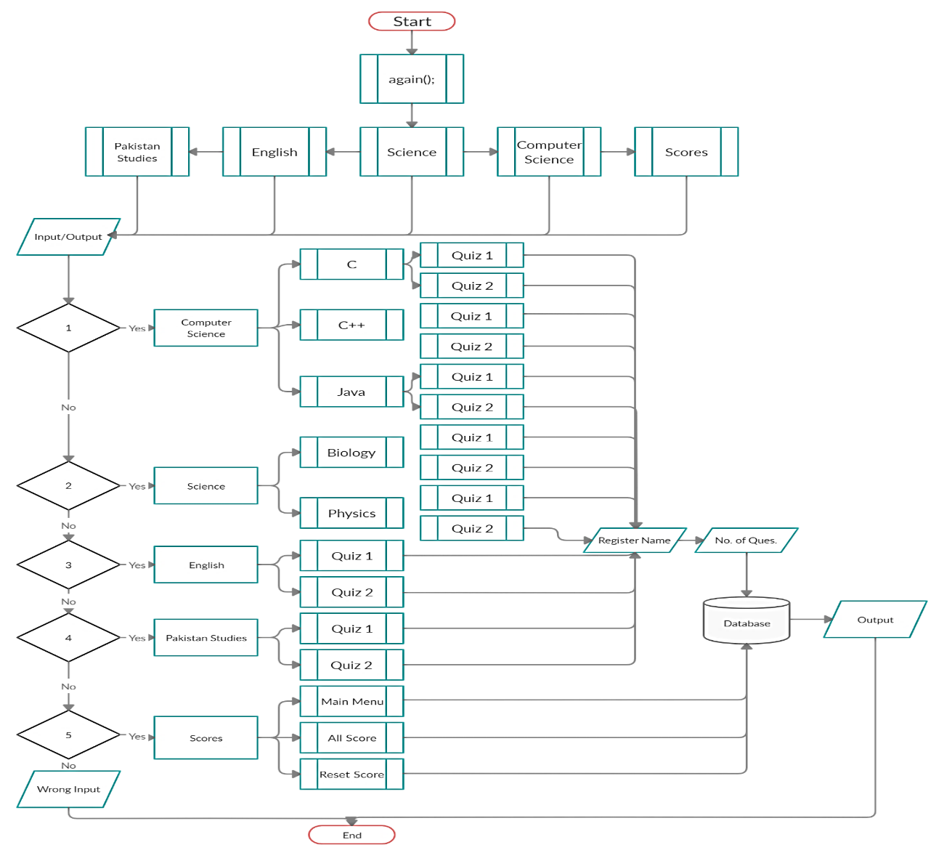
Flow Chart
mainmenu();

Slide 10
Algorithm
Algorithm
1. Start
2. Call mainmenu() function.
3. Get Input (by mainmenu()).
4. Call specific function according to user input.
5. Get Input to get name of the user.
6. Get Input to ask no. of questions.
7. Processing specific function. (Line 4)
8. If the user has given 3 consecutive wrong answers, program will terminate.

Slide 11
Algorithm (cont.)
Algorithm
9. Get the user to ask to jump to main menu, play again or exit.
10. If the user has done quiz without giving 3 consecutive wrong answers, then the result will show on the screen.
11. Save user score against user name.
12. If the previous marks of the user is less, then the current marks will be overwritten.
13. Get the user to ask to jump to main menu, play again or exit.
14. Exit

Slide 12
Functions
1
 | void mainmenu();
 | void pakistanstudies();
5
2
 | void computerscience();
 | void cdata();
6
3
 | void science();
 | void reset_score_c();
7
4
 | void english();
 | void disp_record_c();
8

Slide 13
Functions
9
 | void quizc1();
 | void java1();
13
10
 | void quizc2();
 | void java2();
14
11
 | void qucc1();
 | void physics1();
15
12
 | void qucc2();
 | void physics2();
16

Slide 14
Functions
17
 | void english1();
 | void pakistanstudies1();
21
18
 | void english2();
 | void switchmainm();
22
19
 | void biology1();
 | void scores();
23
20
 | void biology2();
 | void allscore();
24

Slide 15
Functions
25
 | void allreset();
There are 82 functions are used for making the program reliable and user friendly options.

Slide 16
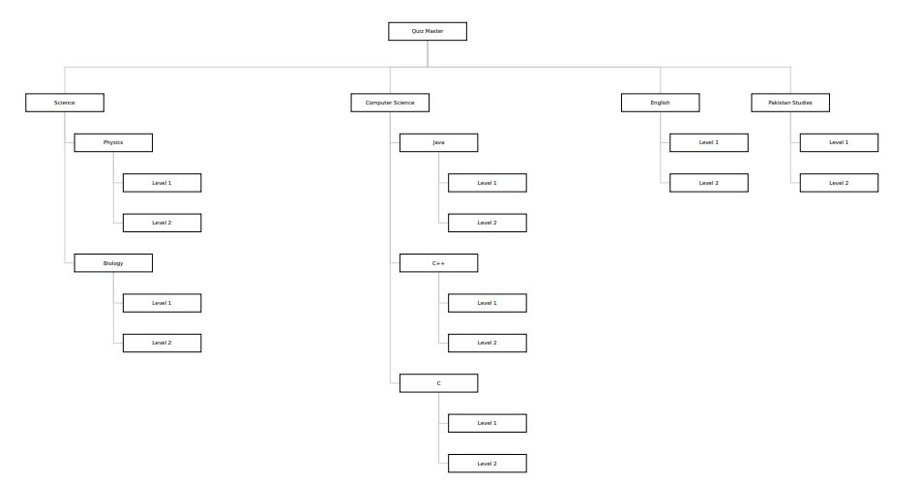
Project Work Down

Slide 17
Distribution of Tasks
Mehar Khan Niazi
Muhammad Azhar
Kirshan Lal
Muhammad Haseeb
Coding + Report
Coding + Report
Coding + Data Gathering
Coding + Testing

Slide 18
Timing Chart
In Days
8
28
10
3
3
10
7
Project
Report
Testing
Coding
Algorithm
Flow Chart
Data
Gathering
Searching

Slide 19
Thank you

